Slide 1
Two-speed Minimizer
By :
Aditi Pradeep
University of British Columbia

Slide 2
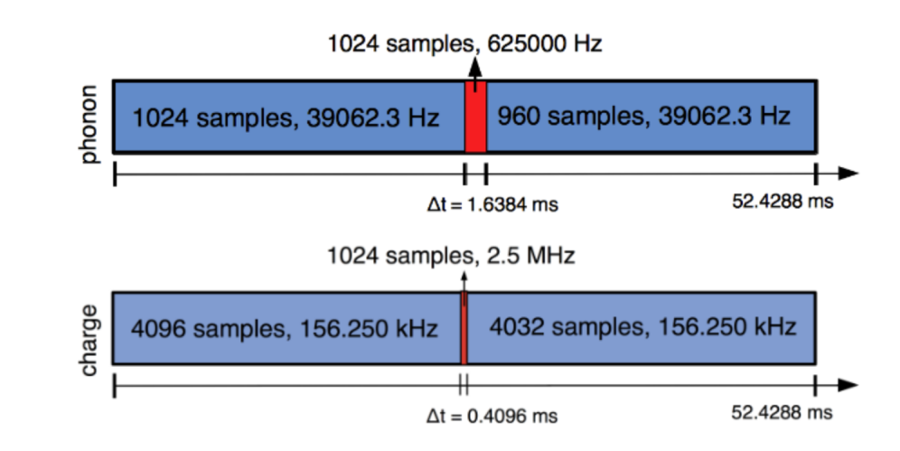
Hybrid readout scheme
Phonon trace
Charge trace

Slide 3
Correlation in hybrid readout
In the optimal filtering process, this results in a change in the covariance matrix - from previously being diagonal to now turning non-diagonal.
The current OF being used is not equipped to handle this change.

Slide 4
Possible solutions
Hybrid optimal filter- Computationally intensive
Apply anti-aliasing before downsampling - Work ongoing
2-speed optimal filter
2-speed minimizer

Slide 5
2-speed optimal filter
Adaptation of existing OF
Handles correlations effectively
Approach: Deals with slow and fast sampled regions separately and combines the results using appropriate covariance matrix.

Slide 6
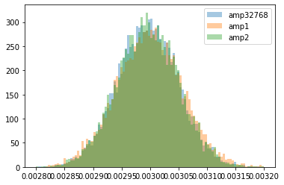
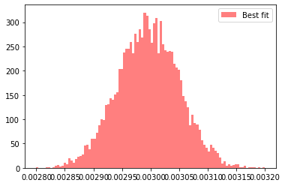
2-speed OF Results
Errors on amplitude estimates:
Fast region fit, A2 : 1.81-1.84%
Uniformly downsampled fit, A1 : 1.9-1.94%
Full trace fit, A32768 : 1.77-1.81%
Combined fit, A0: 1.79-1.82%
Combined fit result is nearly as good as the result from the full non-downsampled trace.

Slide 7
Comments from the last meeting
Dependance of the 2-speed OF on the covariance matrix is important.
Need to test the dependance of the covariance matrix on pulse shape and look at how this affects the final result.
SOLUTION: 2-speed minimizer

Slide 8
2-speed Minimizer
Include pulse-shape parameters in the fit, for eg. fall time of the pulse.
Inclusion of pulse-shape parameters is expected to account for the uncertainty arising from difference in pulse shapes.
Perform the fit using Minuit.
The result is now obtained from a simple 3 parameter fit (amplitude, time delay, fall time).
The fit can be easily extended to include more parameters.

Slide 9
Method
Take a hybrid trace
Minuit
Minuit
Extract fast region
Uniformly downsample signal
A1
t₁^{fall}
t₂^{fall}
A2
t₁^{d}
t₂^{d}
Combine using 6x6 Covariance matrix
COMBINED AMPLITUDE, A0
COMBINED delay, t₀^{d}
COMBINED TFALL, t₀^{fall}

Slide 10
Combining the fit results
Minimizing this chi square numerically returns the best fit parameters A₀, t₀^{d}, t₀^{fall}.

Slide 11
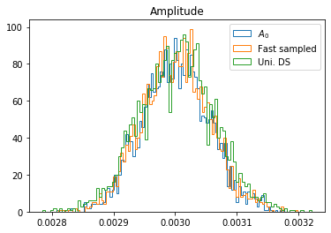
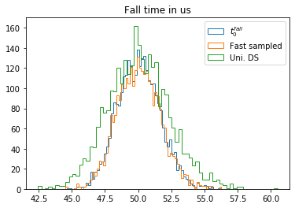
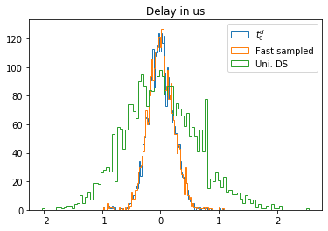
Results

Slide 12
Results
Comparing the different fits obtained
Trace | Amplitude | Delay (std in us) | Fall Time
Fast sampled | 1.82% | 0.2235 | 3.23%
Uniformly downsampled | 2% | 0.58 | 4.41%
Best fit | 1.799% | 0.2233 | 3.20%

Slide 13
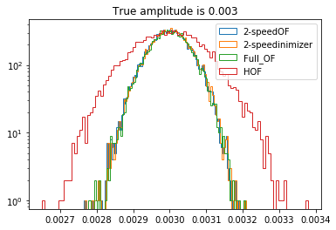
Results
Comparing different methods:
To compare different methods fall time was assumed to be known and delay was set to zero.
Method | Error on amplitude fit
OF | 1.79%
HOF | 3.06%
2-Speed OF | 1.809%
2-Speed Minimizer | 1.81%

Slide 14
Results
Comparing different methods:
The HOF was found to work just as well as the standard OF by Bill Page in his thesis. However, this analysis finds it to be a little worse than the standard OF. We suspect that this might be due to significant numerical errors arising from the matrix inversion step of the HOF or perhaps a previously unaccounted mistake in the HOF implementation. This needs further investigation.

Slide 15
Pros and cons
Pros
Easily extended to more parameters
Easy to adapt into an NxM version
Reduced dependence on pulse shape
Cons
A little slower than 2-speed OF
Occassional non-convergance (~2/3000), but these can easily be separated using a simple chi square cut.

Slide 16
Chi-square function
This method heavily relies on the chisq function and therefore, it is important that its dependance on the fit parameters are accurately represented.
Amplitude and pulse-shape parameter dependance is straight-forward.
Time delay is accounted through the phase term. We can construct this phase term in 2 ways:
1. Hard code the phase term into the chisq and then scan over a window, i.e. bin and then scan for the result.
2. Let the Fourier transform procedure convert the delay into a phase, i.e scan and then bin the result.

Slide 17
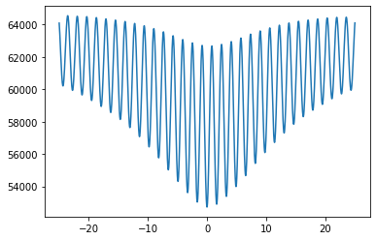
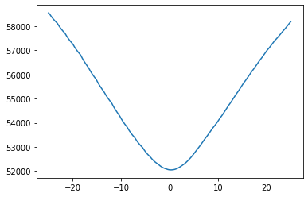
Chisq vs delay (in us)
Hard coding the phase term in chisq function
No hard coded phase term in chisq function
When the phase term is hard coded, it produces squiqqles which are artifacts of the binning. Binning after you fit is a more effective and faster technique.
The 2-Speed minimizer uses the second approach- by actually shifting the analytic template and rebinning it at each step of the fit, rather than by trying to "correct" the phase factors using the complex phase of the FFT coefficients.

